Slide 1

Emmanuel Academies:
Changing the trajectory
of the Church and its future
leadership

Slide 2
Mission:
Forming Skilled Pastors
to Lead
The Lutheran Church into
The Future

Slide 3
Vision:
That there will be sufficient
Skilled Pastors to Teach our
Grandchildren and their
Grandchildren about Christ
And to Preach the Gospel!

Slide 4
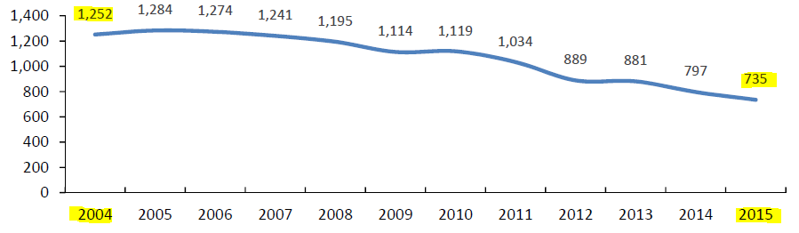

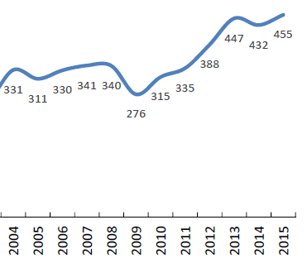
Crisis in ELCA:
M.Div.
Enrollment
Down 40%
Projected
Gap 2021:
1,200
Parishes
Unserved
Pastor
RetirementUp 37%
Source: The Supply and Demand for Clergy in the ELCA, Office of the Presiding Bishop, March 2016

Slide 5
Emmanuel Academies:
Equipping Pastors to Serve
Maintaining High Quality
Highly Innovative & Scalable
Because Great Pastors are Essential
to the Future Life of the Church!!!!!

Slide 6
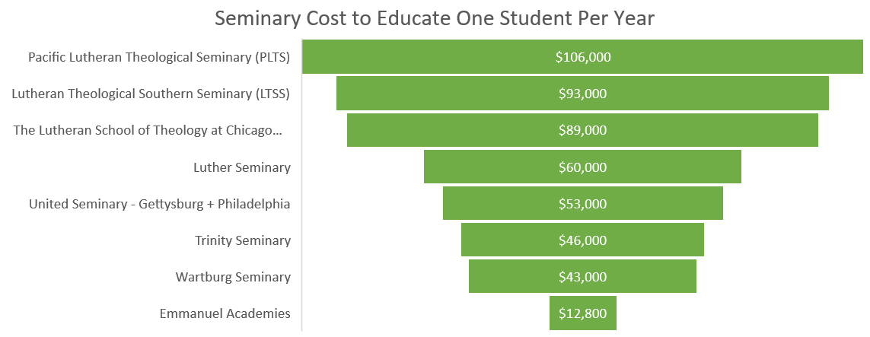
Cost is No Longer
an Issue!
Source: www.ATS.edu 2018-2019 Annual Data Table Sioux Falls Seminary data is used as an estimate for Emmanuel Academies

Slide 7
Leveraging Resources:
Trained Faculty, complemented by:
Successful Pastors
Engaged Congregations
Application of technology
Continually innovating to manage costs
and optimize pastoral formation

Slide 8
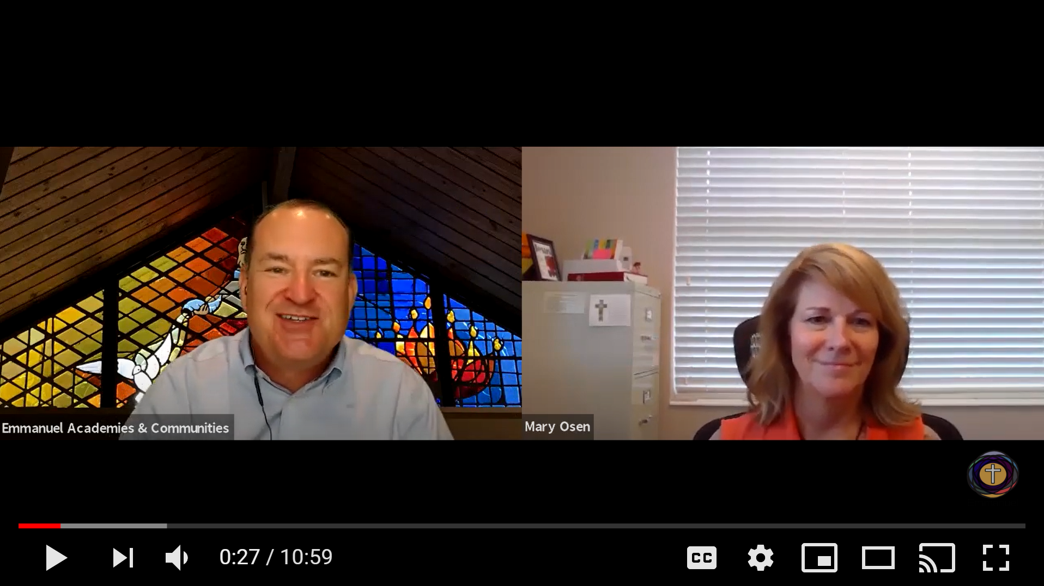
Emmanuel Academies:
Introducing Mary Osen, our first seminarian, from Peace Lutheran!
Called for 15 years. Finally
pursuing her call to Serve!

Slide 9
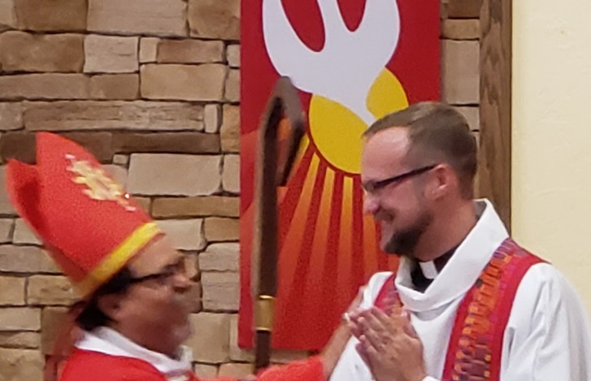

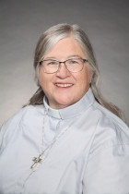
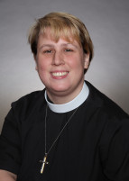
Proof of Concept:
Former
Pastoral Residents:
Current
Pastoral Residents:

Slide 10
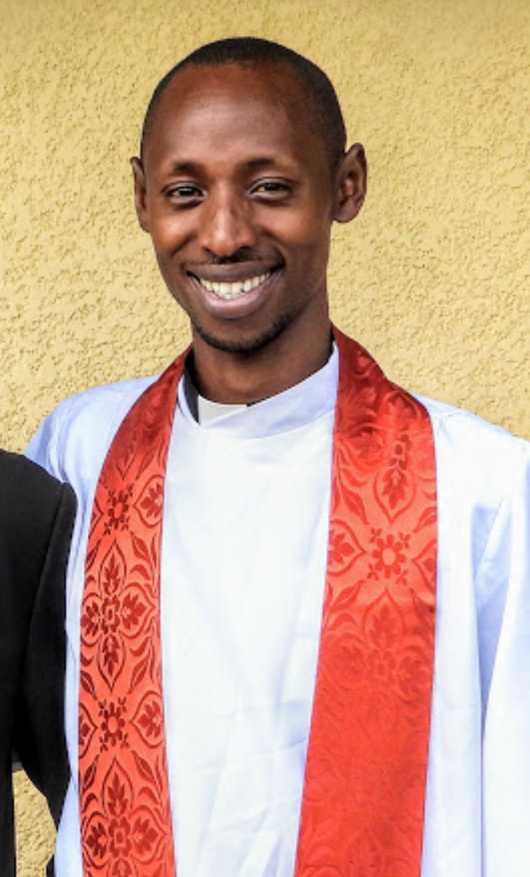
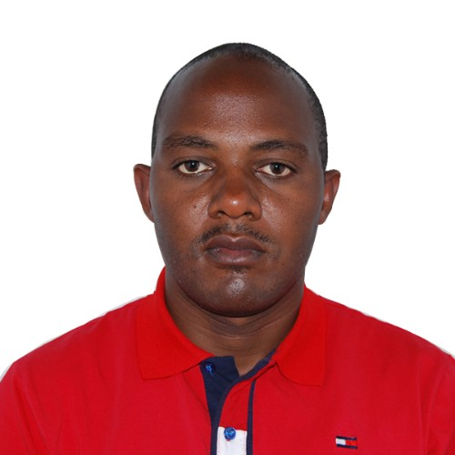
Spring 2020 Masters in Divinity Students:
Pr. Edward Makara
Lutheran Church in
Rwanda
Pr. Muzigura Faustina
Lutheran Church in
Rwanda
Robert Byilingiro
Lutheran Church in
Rwanda
Eugene Muhere
Lutheran Church in
Rwanda
Mary Osen
Peace Lutheran Ft Myers

Slide 11
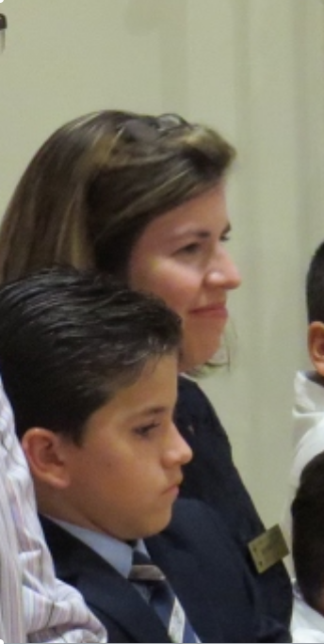
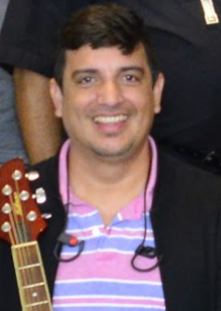
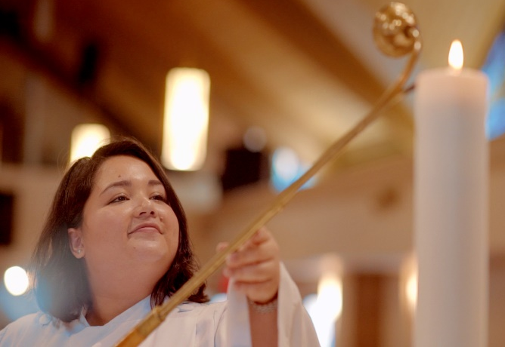
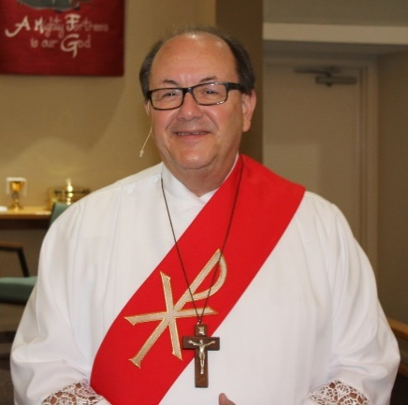
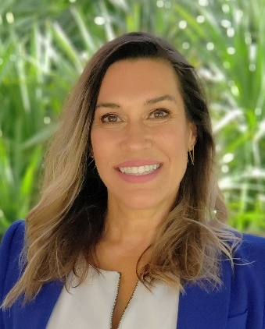
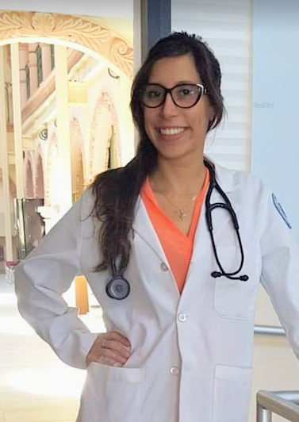

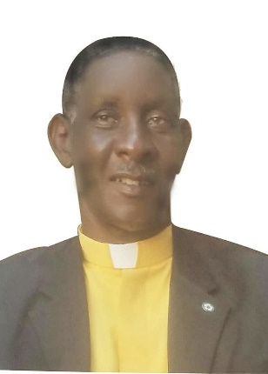
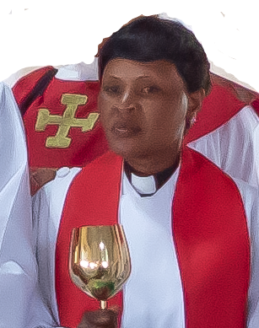
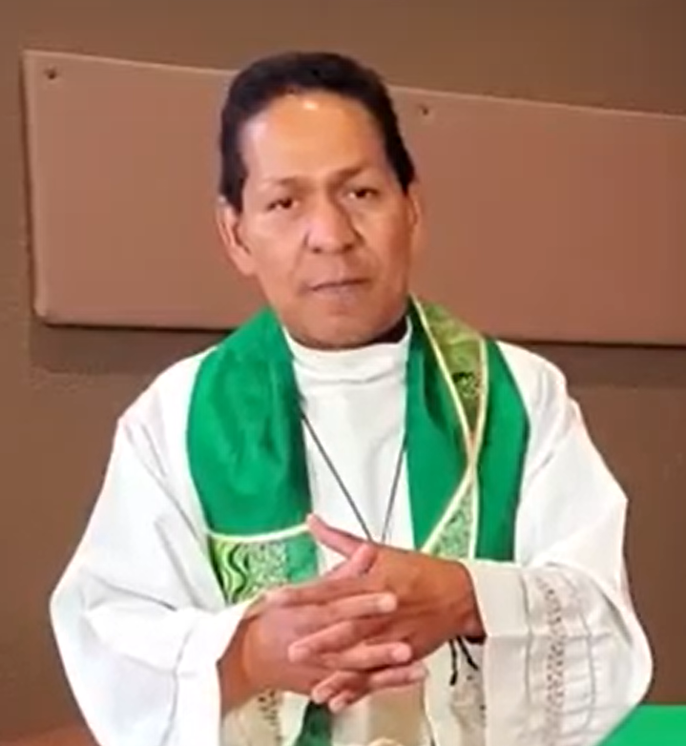
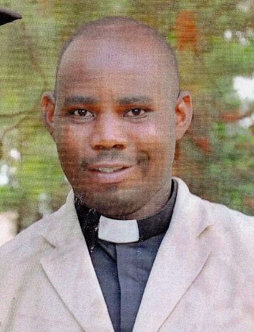
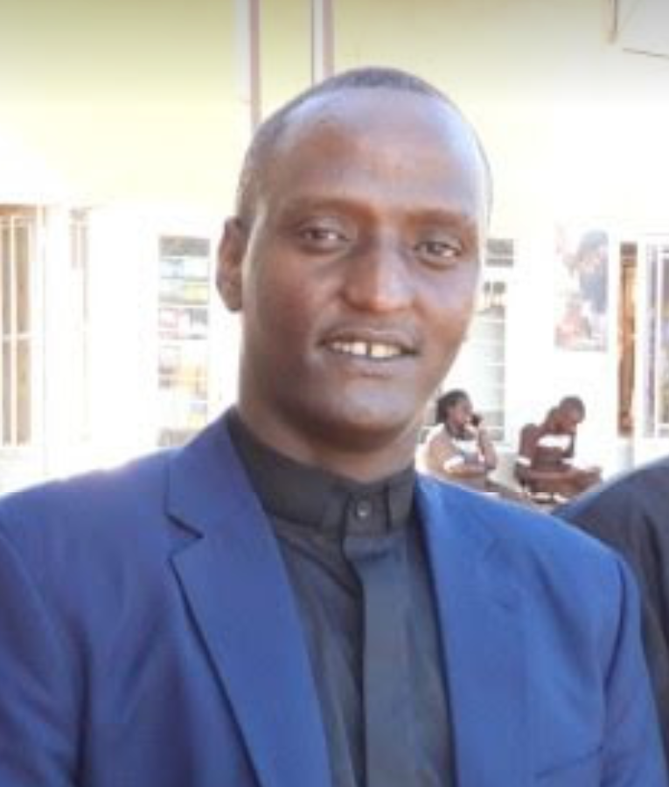
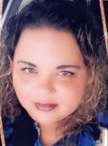
Fall 2020 Masters in Divinity Seminary Cohort:
Ann Marie Gomez
Frine Donadelli
Bob Bonomo
Julio Ruiz
Beatrice D’Angelo
Flor Chavez
Rev. Theonest
Rev. Chantal
Pr. Alvaro Nova
Rev. George
Johanna
Figueroa
Rev. Eddy

Slide 12
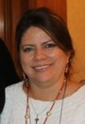
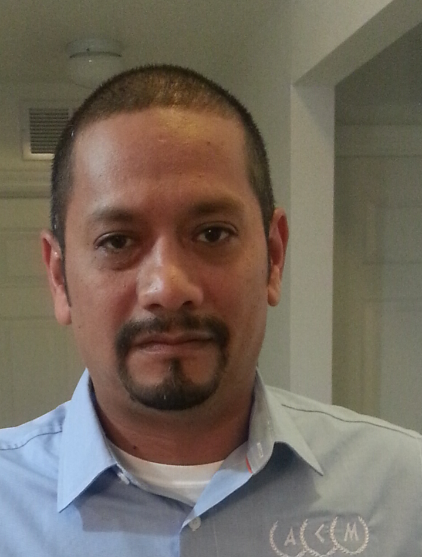
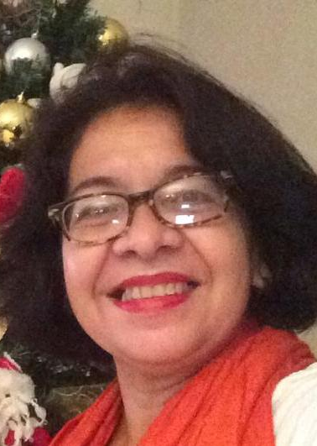
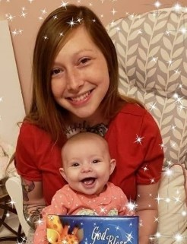
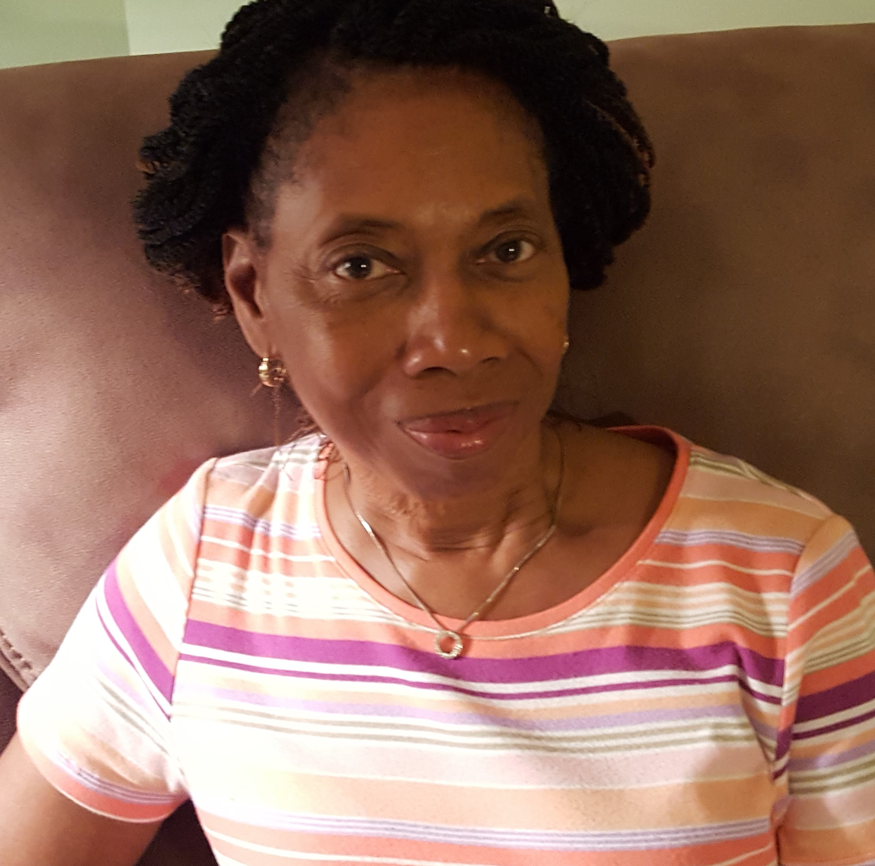
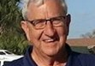
Spring 2021 Master of Divinity Seminary Cohort
Bishop Karen Castillo
Alberto Gomez
Clecepmary
Rodriguez Suarez
Torye Angelatos
5-Year BA + MDiv
Paula Bobb-Semple
Deacon Richard Mainster

Slide 13
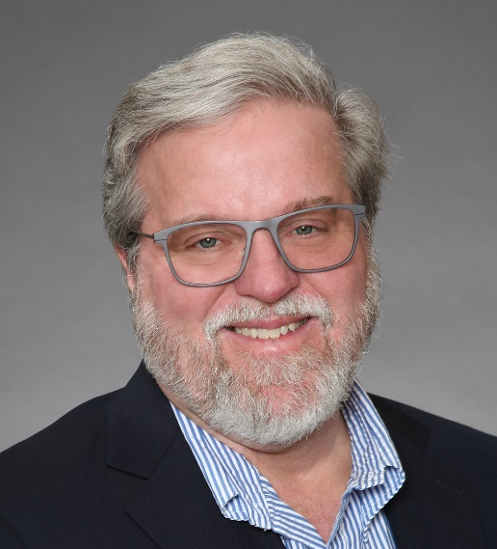
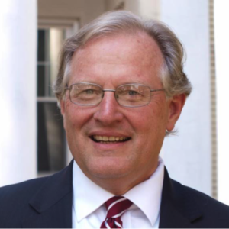
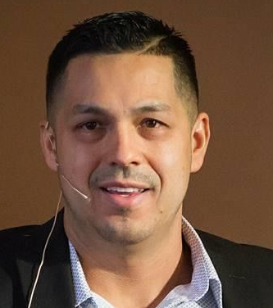
Our Faculty Leadership
Rev. Dr. Richard Bliese
Rev. Dr. Clay Schmit
Rev. Jhon Correa
Former President of
Luther Seminary, Dean
Of Lutheran School of
Theology at Chicago,
Ordained ELCA Pastor
Former President of
Luther Theological Southern Seminary, faculty at Fuller Seminary,
Ordained ELCA Pastor
PhD Candidate at Lutheran School of Theology at Chicago, Ordained ELCA Pastor

Slide 14
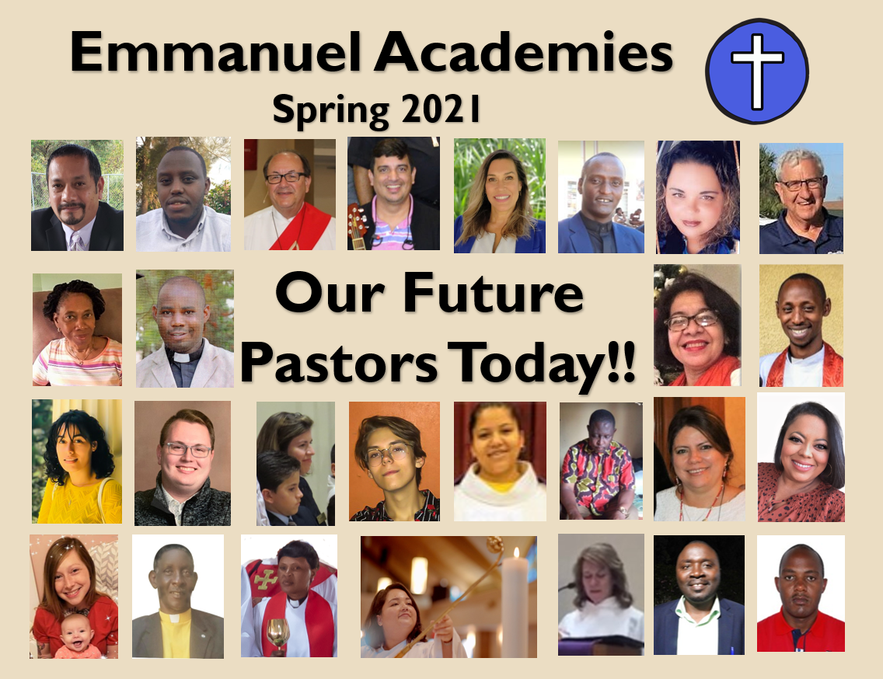

Slide 15

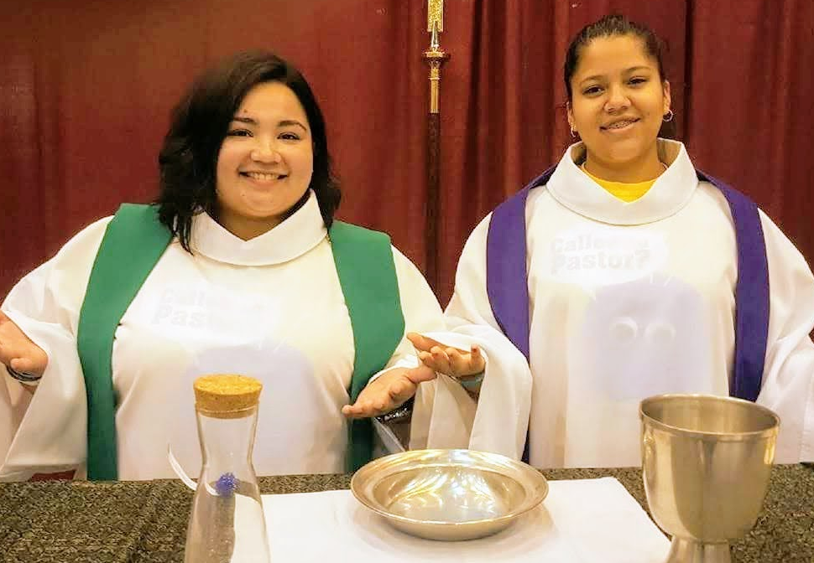
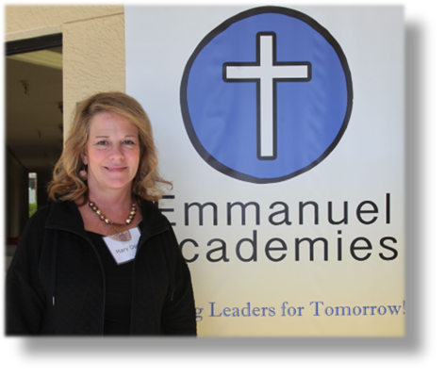
Thank you for you
Prayers and Support!

